Slide 1

Business Rules and Constraints

Slide 2
What Are Business Rules?
A business rule is a statement that imposes some form of constraint on a specific aspect of the database.
Example:
A Ship Date cannot be prior to an Order Date for any given order.

Slide 3
Categories of Business Rules
Field-Specific
Relationship-Specific

Slide 4
Field-Specific Business Rules
An email address is required for each customer.
The postal code must allow for both US and Canadian postal codes.

Slide 5
Relationship-Specific Business Rules
A product is assigned one and only one category.
A product must be assigned at least one category and may be assigned many categories.
A product may be assigned zero to many categories.
Each class must have a minimum of five students, but cannot have more than 20.

Slide 6
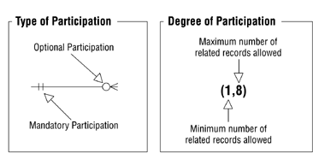
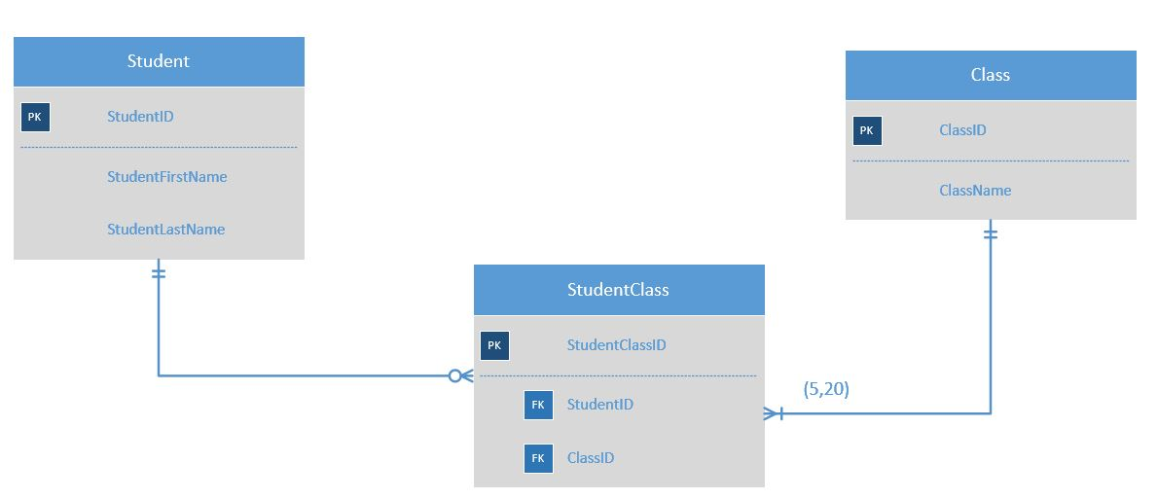
Participation

Slide 7
Which one do you focus on first?
Field-Specific
Relationship-Specific

Slide 8
Validation Tables
Categories
States
Category ID | Category
60001 | Architects
60002 | General Contractors
60003 | Attorneys
60004 | Computer Consultants
State | State Name
AL | Alabama
AK | Alaska
AR | Arkansas
CA | California

Slide 9
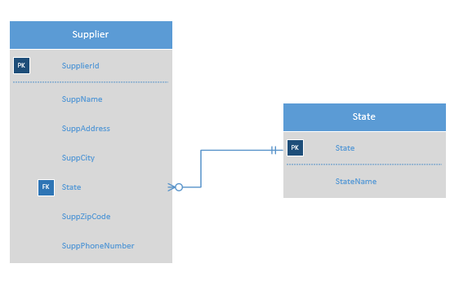
Validation Tables

Slide 10
Constraints

Slide 11
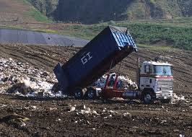
Constraints help us to avoid this…

Slide 12
Constraints
Constraints are restrictions on the contents of the database.
Database constraints provide a way to maintain data integrity.
Rows in a table have valid primary or unique key values.
Rows in a dependent table have valid foreign key values that reference rows in a parent table.
Individual column values are valid.

Slide 13
Constraint Terms
Domain constraints
data types
default constraints
not null constraint
unique constraints
check constraints
Key/table constraints
primary key constraints
foreign key constraints
referential integrity

Slide 14
Data Type Constraint
EmployeeID must be an integer

Slide 15
Default Constraint
If you know that the majority of your record entries are from the United States, you may plan to constrain the CountryRegionfield so that it has a default entry of ‘United States’ which you could override as needed.

Slide 16
Not Null Constraint
You may plan to constrain the OrderDatefield so that it does not allow nulls.

Slide 17
Unique Constraint
You may plan to constrain the EmailAddress field so that each value is unique.

Slide 18
Check Constraint
You may plan to constrain the ShippedDate field so that it is a date greater than or equal to the OrderDate.

Slide 19
Foreign Key Constraints or Referential Integrity
An Employee record must exist in the Employee table before you can add an Order record in the Order table taken by that Employee.
In other words, you cannot enter a record in the Orders table with an EmployeeID that does not already exist in the Employee table.

Slide 20
The End

